Slide 1
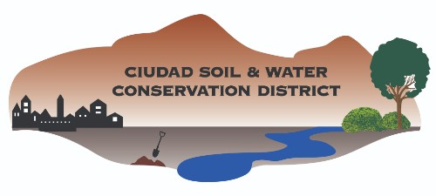
CIUDAD SOIL AND WATER CONSERVATION DISTRICT:
PARTNERS IN CONSERVATION
September 2024
We’re from the government,
and we’re here to help!

Slide 2
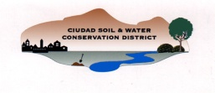
We’re not MRGCD!
Middle Rio Grande Conservancy District
  Created in 1923 by the federal government
  Initial purpose: Drain the middle valley and prevent flooding
  Current purposes: Irrigation management (Bernalillo to San Marcial) and flood control
Ciudad Soil and Water Conservation District
  Formed in 1944 by a referendum of landowners under the NM Soil and Water Conservation District Act (Special District)
  Initial purpose: Help farmers recover from and prevent another Dust Bowl
  Current purposes: Natural resource conservation education, demonstration and implementation
Background

Slide 3
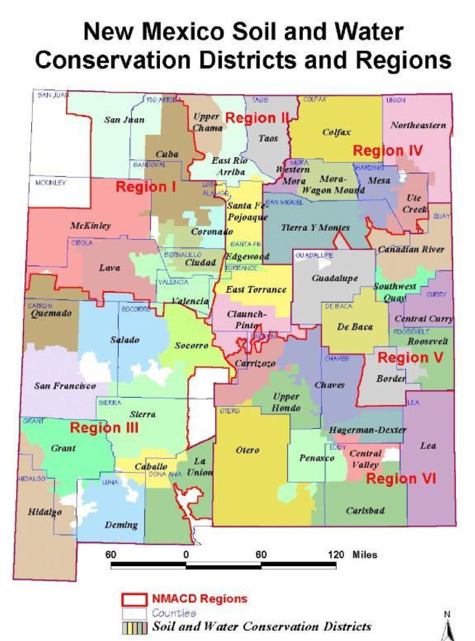
We’re one of 47 SWCDs statewide, but nearly half of the population resides within our District boundaries
Background

Slide 4
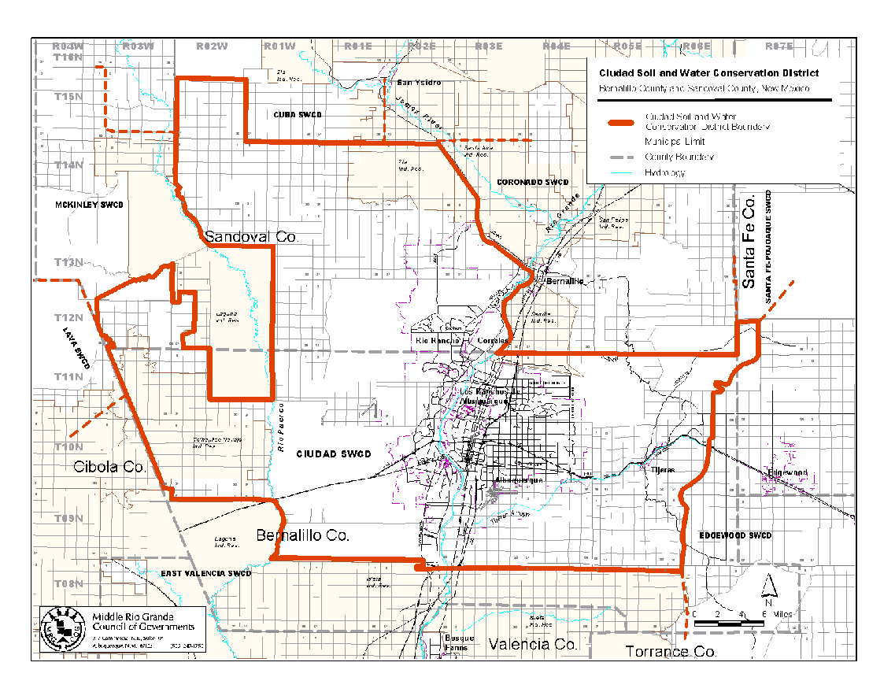
Ciudad SWCD Boundaries
Background

Slide 5
Ciudad SWCD Constituencies
Sandoval County: Open range, platted
Village of Corrales: Semi-rural, semi-ag
918,000 acres
>750,000 residents
City of Rio Rancho: Urban, non-ag
Background
North Valley: Semi-urban, semi-ag
West Mesa: Open range, grazing
Los Ranchos de ABQ: Semi-urban, non-ag
City of Albuquerque: Urban, non-ag
Bernalillo County: Semi-urban, ag
Village of Tijeras: Semi-urban, non-ag
To'hajiilee Navajo: Rural, open range
East Mountains: Semi-rural, forest
South Valley: Semi-rural, ag
Mesa del Sol: Open range, planned development

Slide 6

Support System
NRCS (Unfunded Collaborative Agreement)
  Donated office space and office equipment
  Technical expertise
NMDA (Memorandum Of Agreement)
  State operational funding conduit
  Parliamentarian, regulatory consultant
SWCDs (formal and informal collaborations)
  Coronado SWCD
  Valencia SWCD
  Edgewood SWCD
  Claunch-Pinto SWCD
Background

Slide 7

Personnel
Board of Supervisors (volunteers)
  5 elected Board members with 4-year terms
  2 appointed Board members
  1 Associate Supervisor (ex-officio)
Staff
  5 Managers: District Manager, Education, Forest Health, Agriculture, Finance
  3 Coordinators (part-time)
  1 Urban Waters Coordinator
Contractors & Volunteers
  Forest health assessors
  Forest thinning teams
  Elementary educators
Background

Slide 8
Duties & Powers
Conduct research, investigations and surveys treating soil erosion and floodwater and sediment damage [73-20-44(A) NMSA 1978]
Demonstrate by example the methods by which soil and other natural resources may be conserved [73-20-44(C) NMSA 1978]
Assist, contract with and render financial aid to district landowners and state or federal agencies … that are engaged in erosion control and prevention projects, flood prevention works or the conservation, development, utilization and disposal of water within the district [73-20-44(D) NMSA 1978]
Develop comprehensive plans for natural resource conservation, development and utilization, including flood prevention, control and prevention of soil erosion and the development, utilization and disposal of water [73-20-44(F) NMSA 1978]
Act as agent for any instrumentality or agency of the state or of the federal government in the acquisition, construction, operation or administration of a natural resource conservation, utilization or development project [73-20-44(I) NMSA 1978]
Collaboration is key!
Background

Slide 9

Strengths
80 years of local experience and connections
State government entity so no RFP for services
NM Anti-donation Clause exemption so resources can benefit any entity, public or private
Nimble organization and quick decision-making while ensuring compliance with state laws and regulations
Low overhead (~10%) so 90% of
invested funds are used for projects
Broad expertise in natural and
cultural resource preservation in
urban and wildland-urban interface
Well-developed public education
programs
Background

Slide 10

Funding
NM Legislature
  ~ $20,000/year ($70,000 this FY!)
  Allocated through NMDA
Grants/Partnerships
  $2.5 Milliion Dollars in FY 2025
  State and federal sources
Intergovernmental Agreements
  $800,000 in FY 2025
  Local government partners
Subdivision reviews
  ~ $1,000/year
Funding

Slide 11
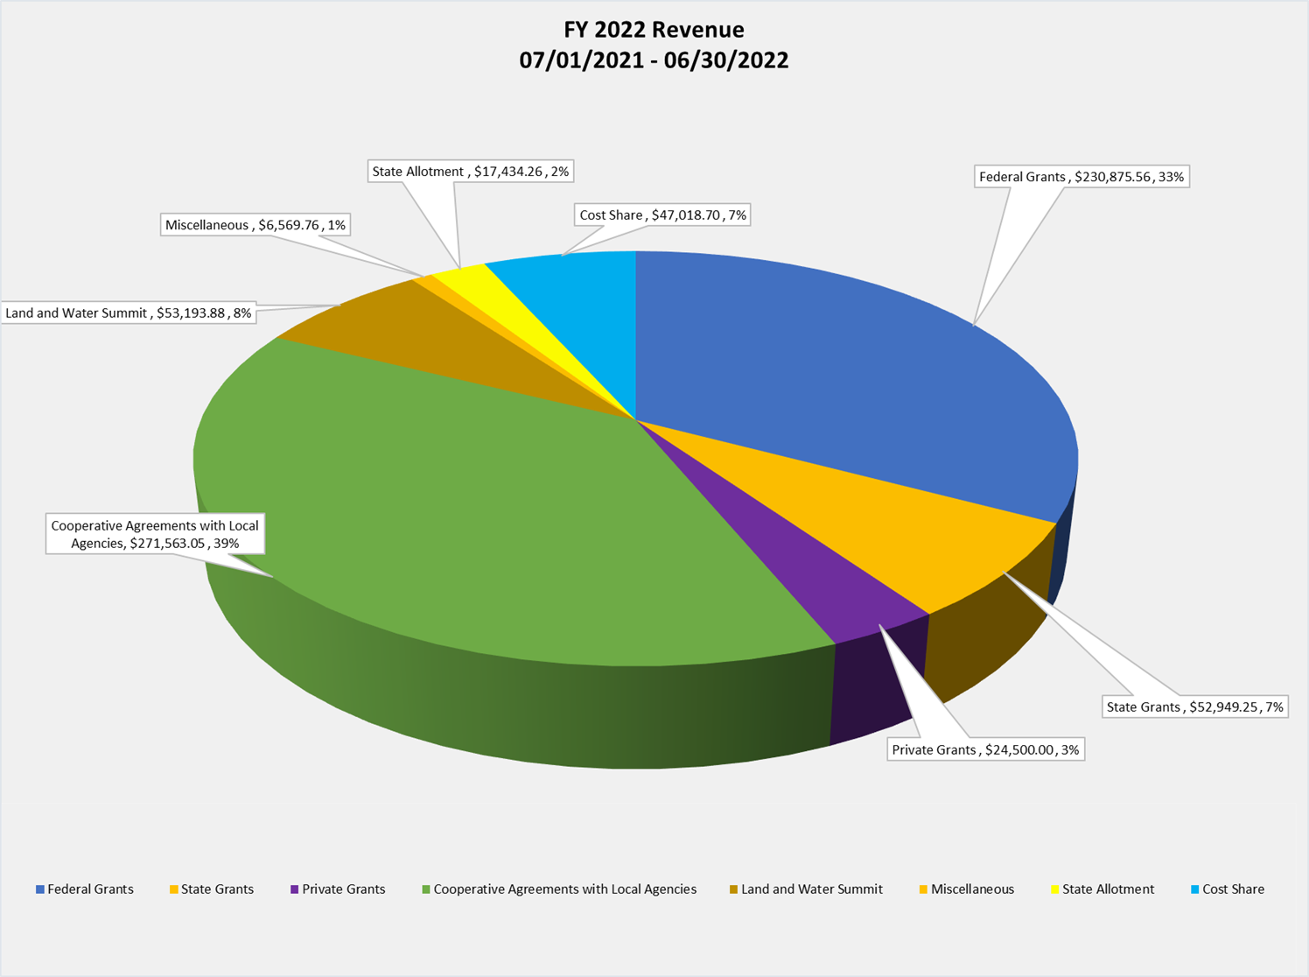
Leveraged Revenues
Funding
Notes:
Total Revenue in FY 2022 $704,107.47

Slide 12
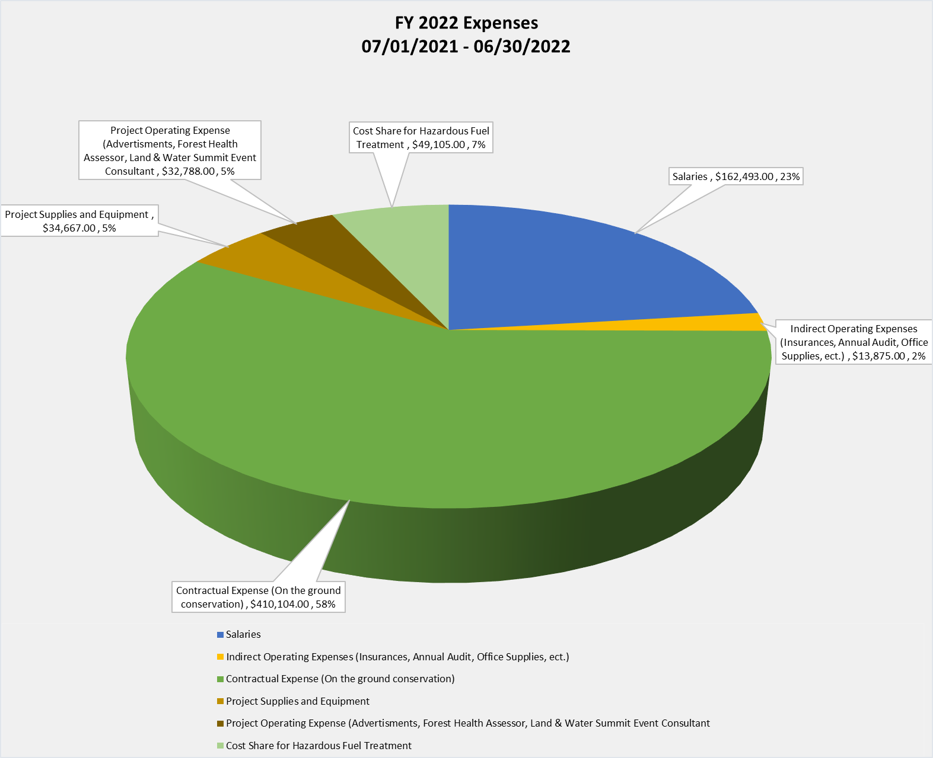
Minimized Overhead
Funding
Notes:
Total Expenses in FY 2022 $703,031

Slide 13
Mill Levy Referendum
Property tax (mill levy) collection is authorized by NM Soil & Water Conservation District Act
Reliable income will enable Ciudad SWCD to supplement grant funding, strengthen partnerships and expand services
Mill levy referendum on the November 2024 ballot
  Maximum additional property tax of 0.25 mill
  Roughly $16 per year for average homeowner
Funding
Notes:
Total Expenses in FY 2022 $703,031

Slide 14
Collaborations
Greater Rio Grande Watershed Collaborative
Arid Low Impact Development Coalition
Tijeras Creek Watershed Collaborative
Sandia Collaborative
Urban Waters Federal Partnership
Bosque Ecosystem Monitoring Program
Bernalillo County Master Composters
Bernalillo County Master Naturalists
Children’s Water Festival
MRCOG Water Resources Board
Rio Grande Water Fund
City of Rio Rancho
ABQ Backyard Refuge
Collaborations

Slide 15

Project Partners ($$$)
Natural Resource Conservation Service/USDA
NMEMNRD State Forestry Division/USFS
New Mexico Department of Agriculture/USDA
New Mexico Environment Department/USEPA
New Mexico Department of Outdoor Recreation
New Mexico Counties/USBLM
Middle Rio Grande Storm Team/SSCAFCA
Rocky Mountain Youth Corps
Ancestral Lands Conservation Corps
City of Albuquerque Open Space
Bernalillo County
Rio Grande Return
Albuquerque Public Schools
Partnerships

Slide 16
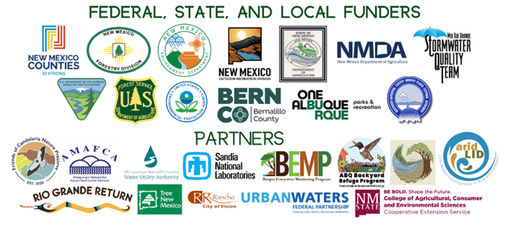
Partnerships

Slide 17

Resource Concerns Projects
Resource Concerns established in Long Range Plan
RCs with recent and current projects
  Natural Resources Education
  Urban Agriculture and Soil Health
  Wildland-Urban Interface (WUI) Wildfire Risk Reduction
  Urban/WUI Watershed Health
  Wildlife/Wetlands/Watershed
RCs with older projects
  Water Quality
  Water Availability
  Liquid and Solid Waste
Resource Concerns

Slide 18
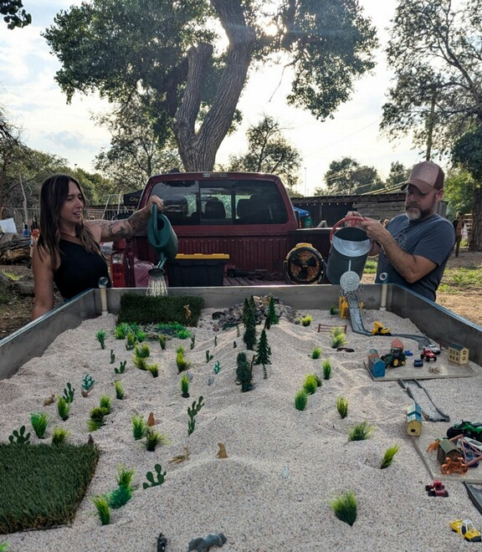
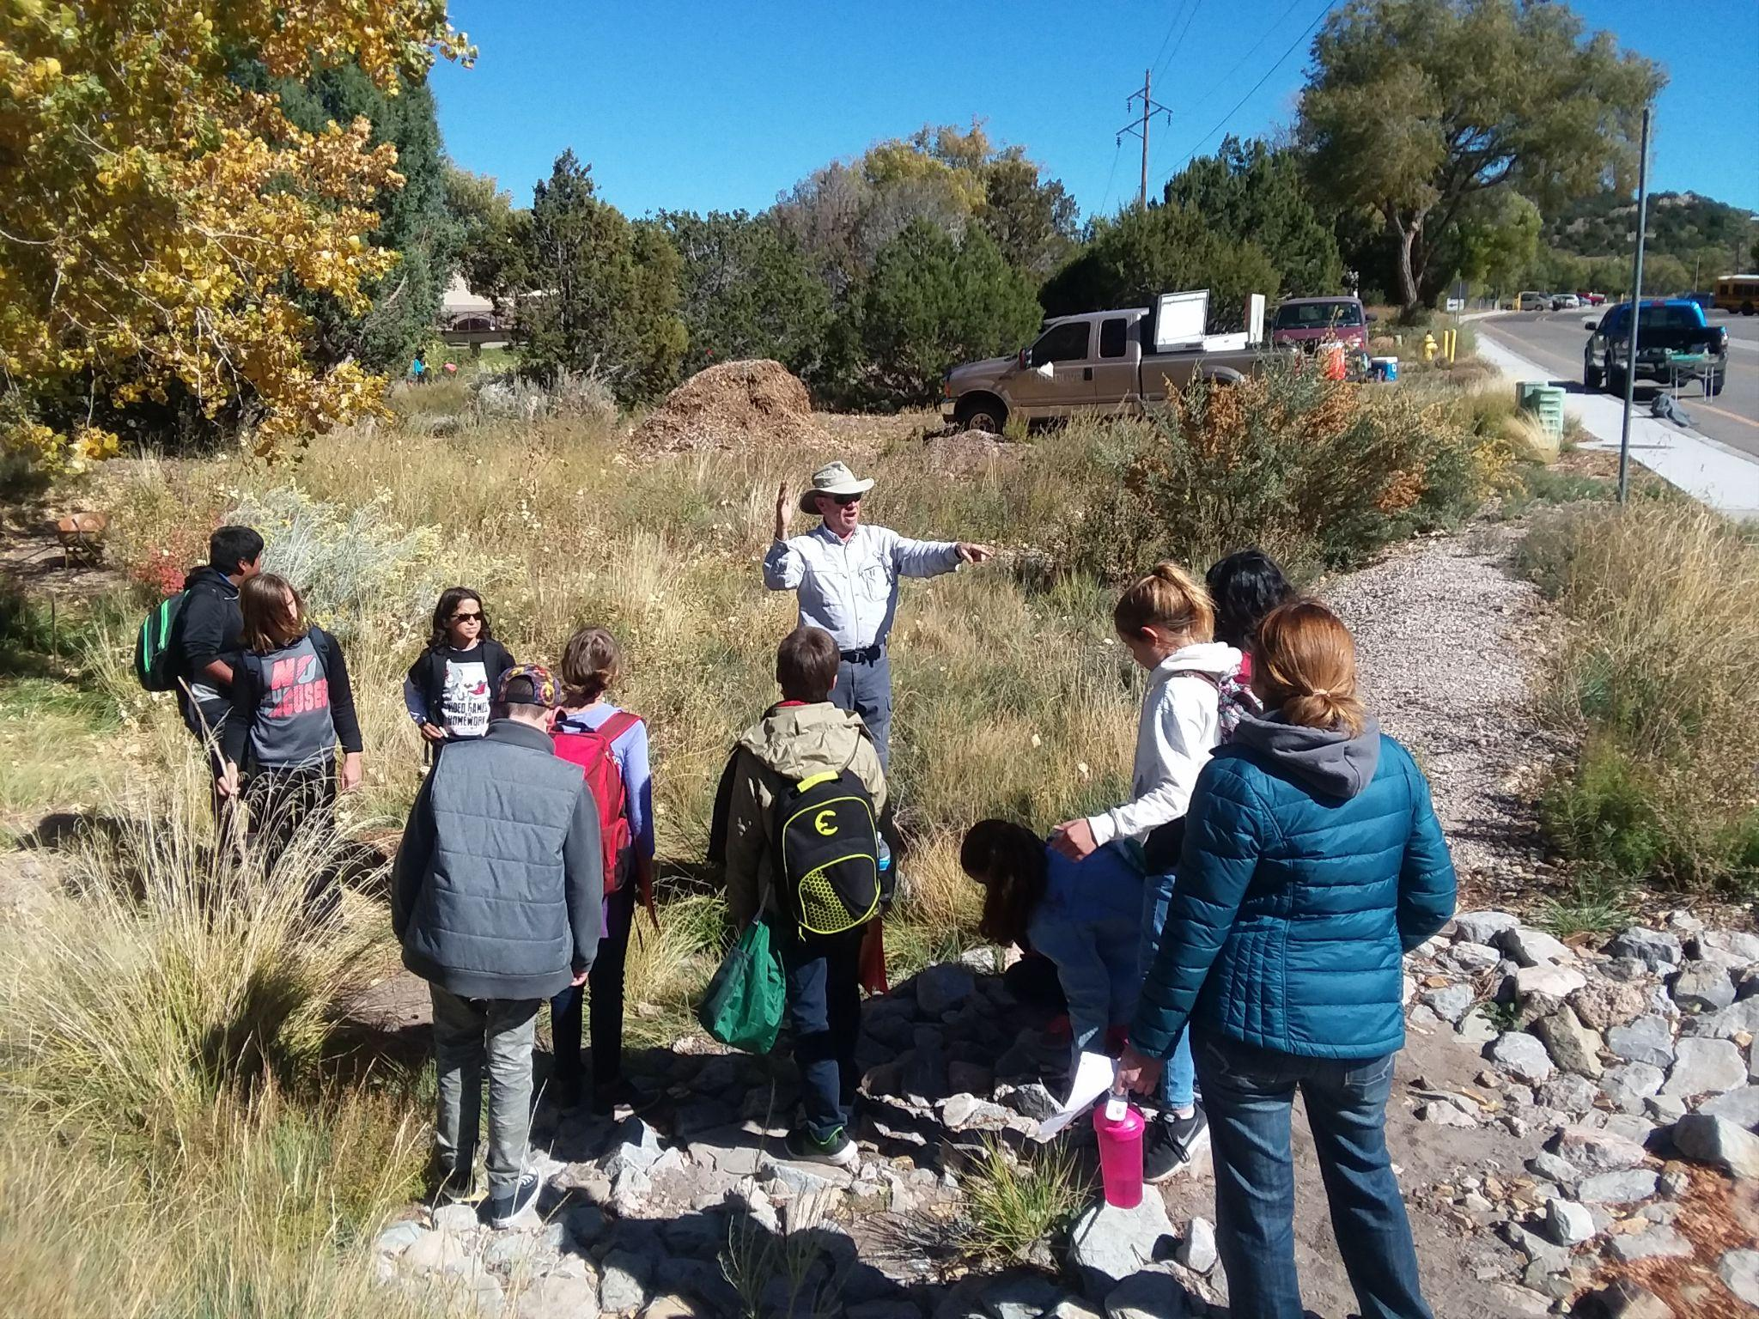
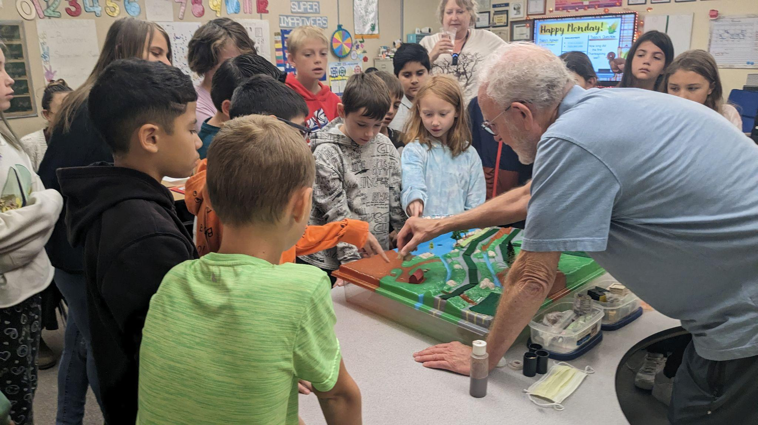
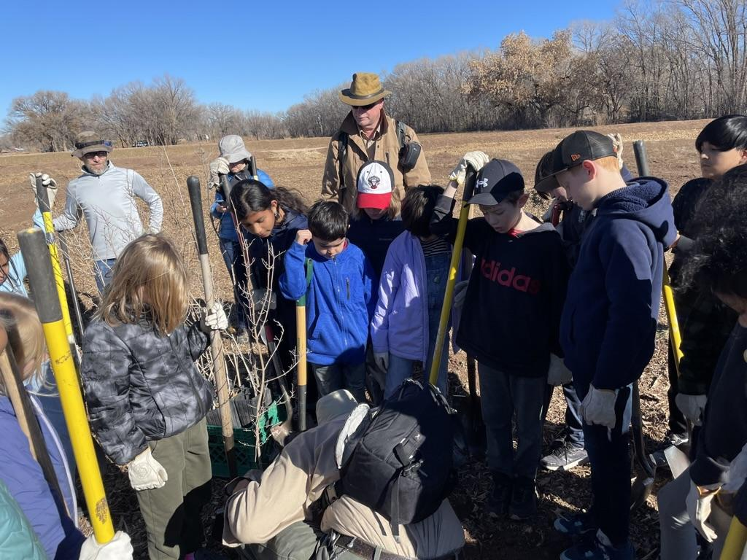
Natural Resources Education
Project Areas

Slide 19

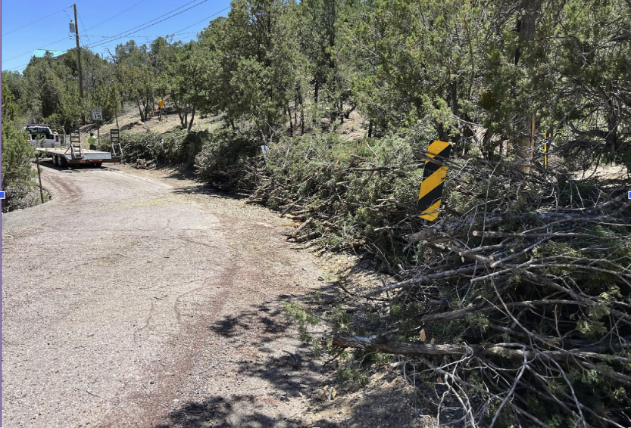
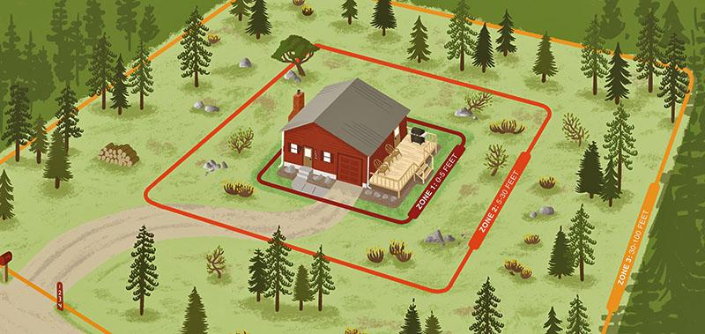
Natural Resources Education
New Mexico Counties
    Rural Communities Wildfire Risk grant
  Defensible space education for land owners
  Community chipper days
Project Areas

Slide 20
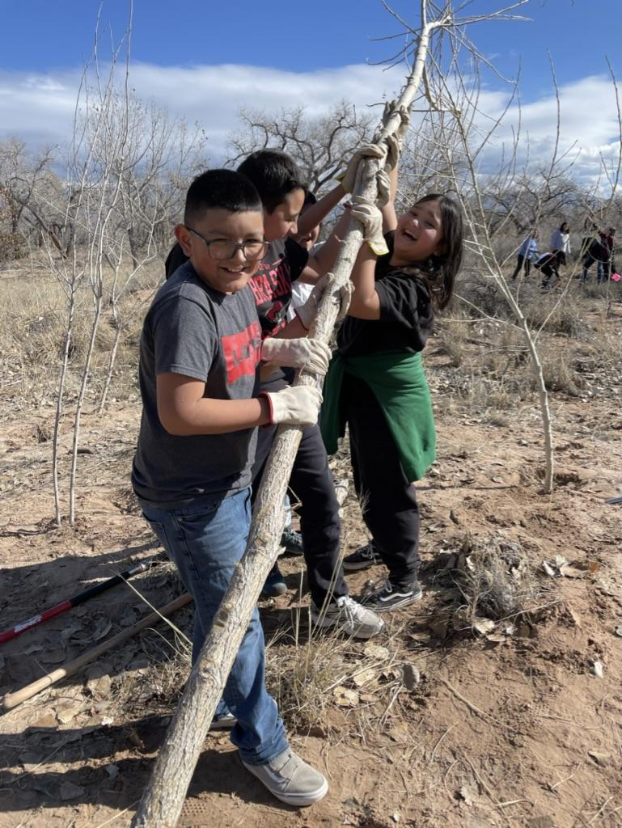
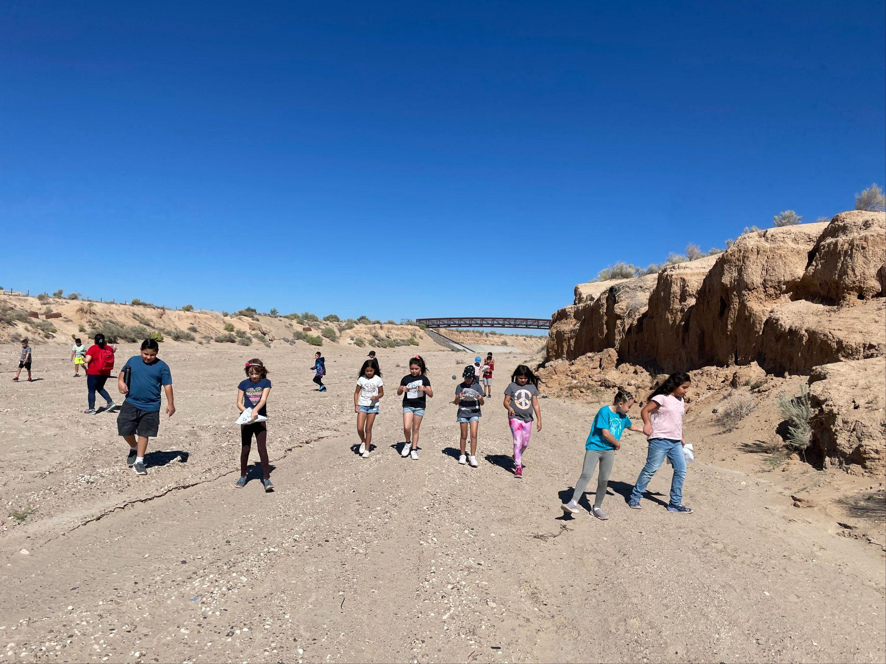
Natural Resources Education
Middle Rio Grande Stormwater Quality Team/SSCAFCA
    Memorandum of Agreement
  RiverXchange 5th-grade water resources education (1000 Students)
  Arroyo Classroom 3rd-grade arroyo safety and wildlife habitat (700 Students)
Project Areas

Slide 21
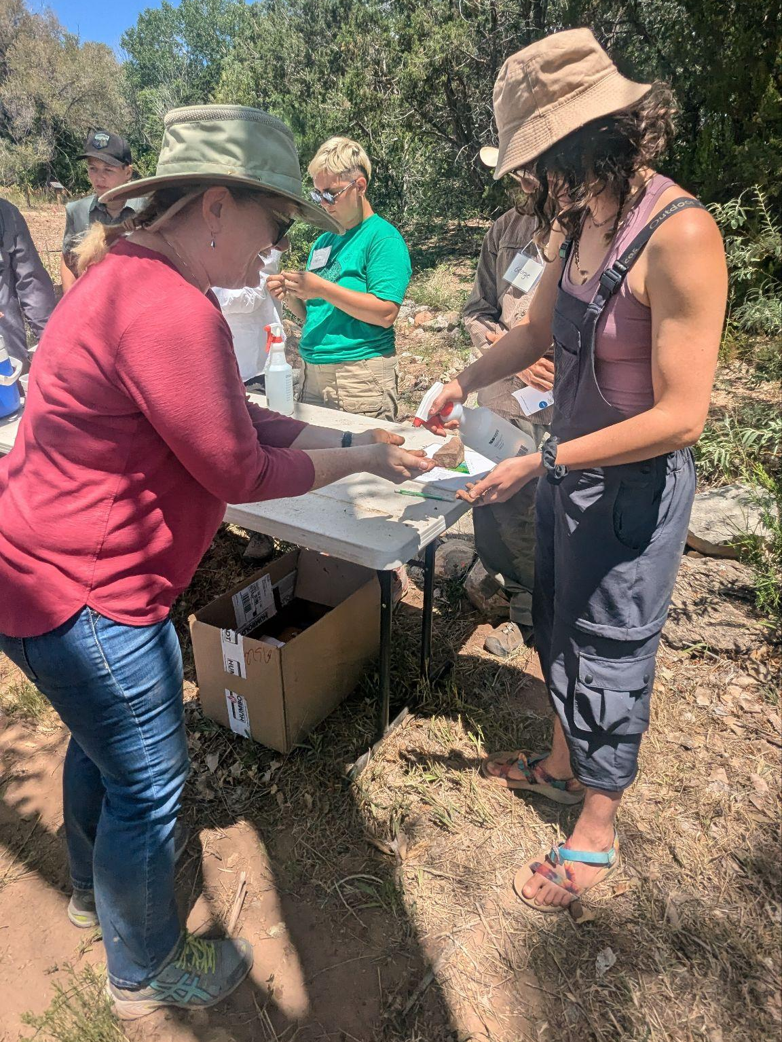
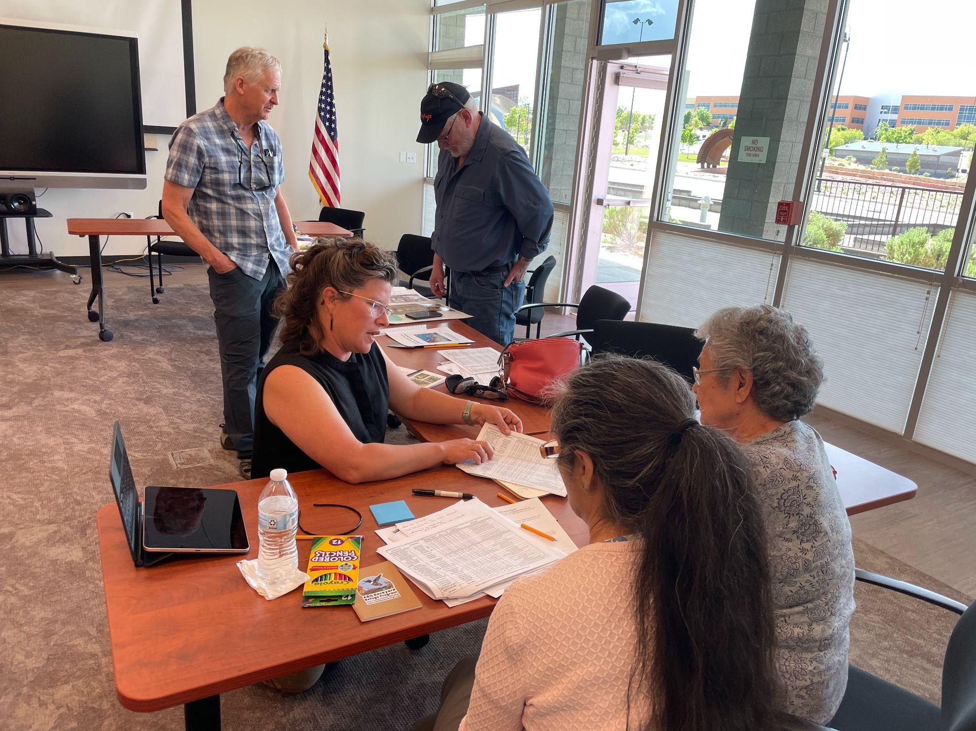
Natural Resources Education
Southern Sandoval County Arroyo Flood Control
    Memorandum of Agreement
  Watershed Stewards seniors’ education
  Collaboration with the Friends of Valle de Oro Backyard Refuge Program
Project Areas

Slide 22
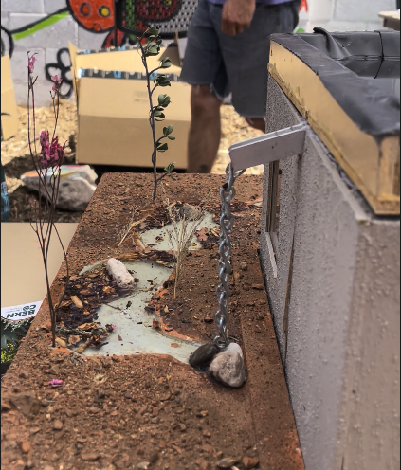
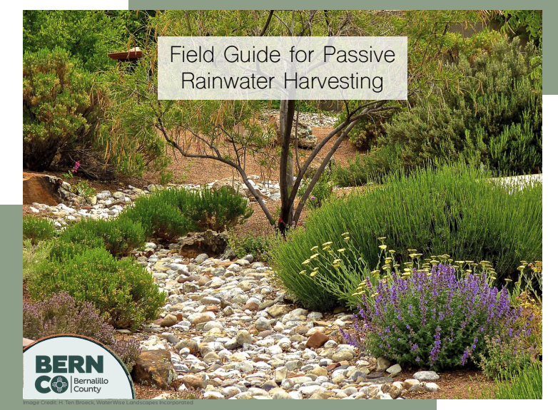
Natural Resources Education
Bernalillo County
    Intergovernmental Agreements
  Natural Resource Services: Residential Rainwater Harvesting Installation Program Pilot
  Open Space: Master Naturalists Program
Project Areas

Slide 23
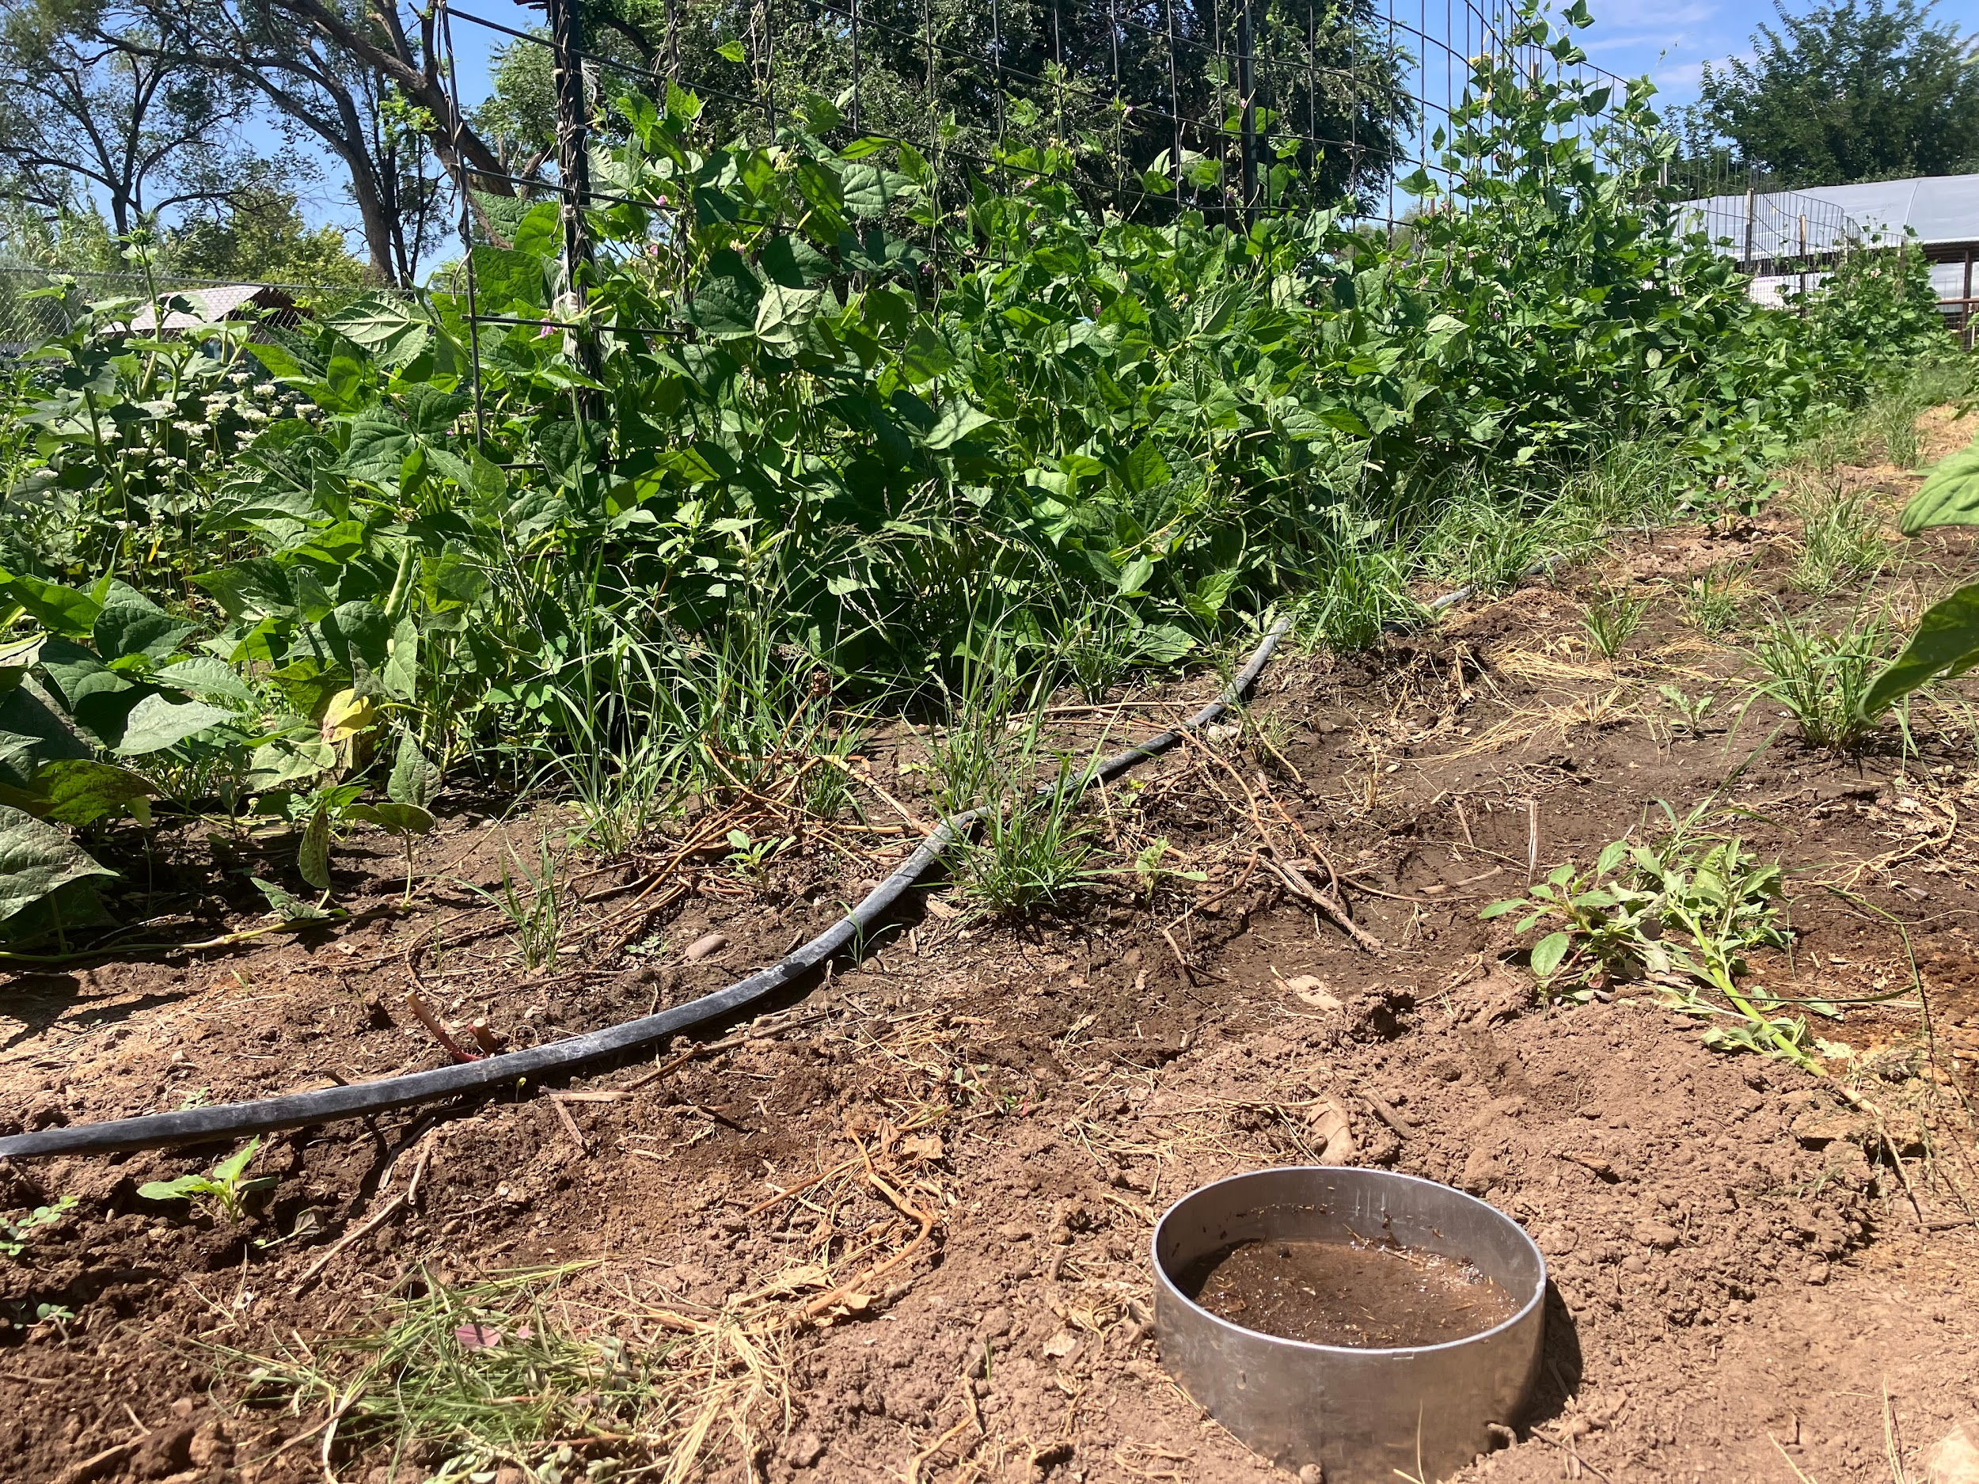
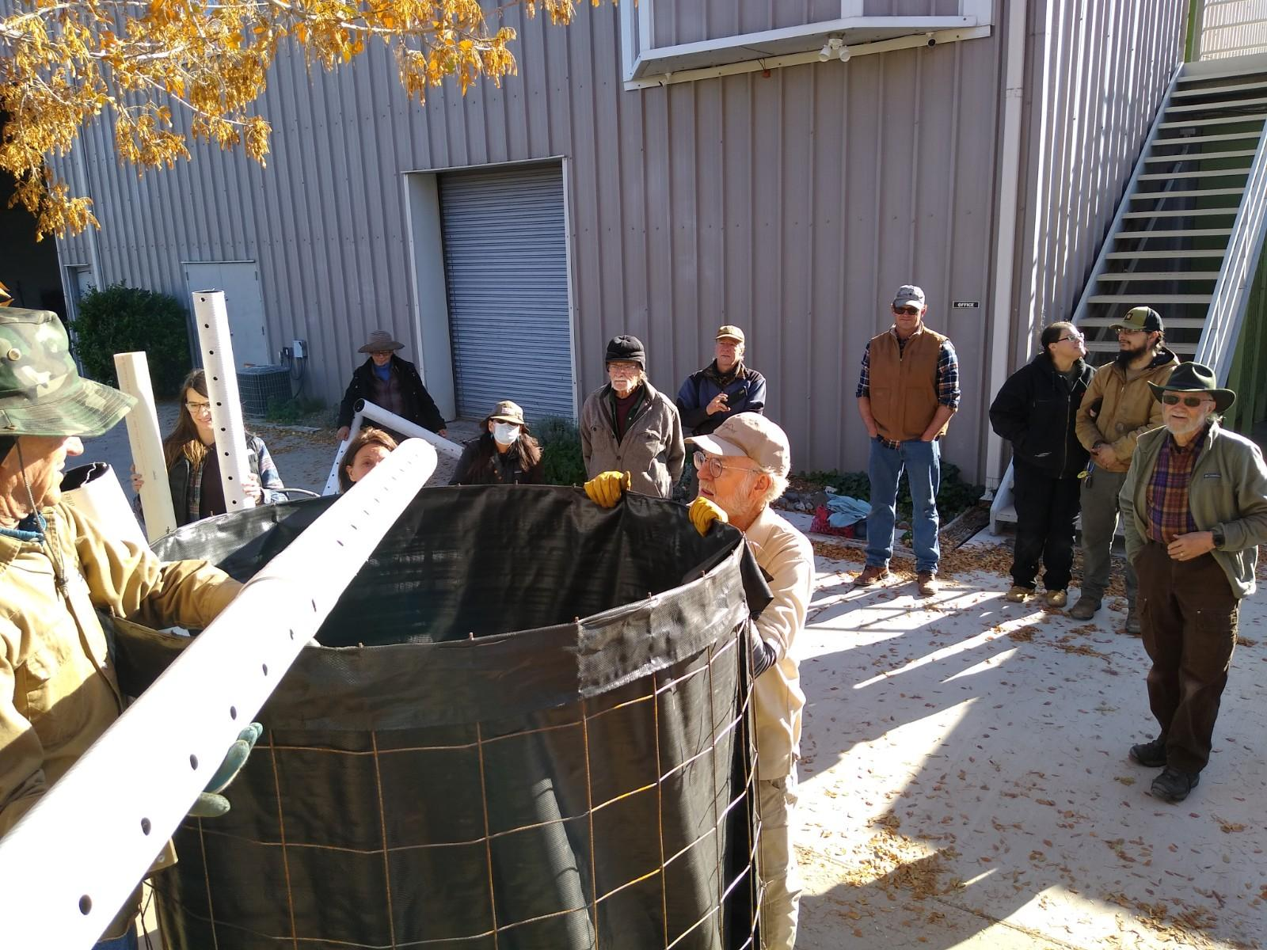
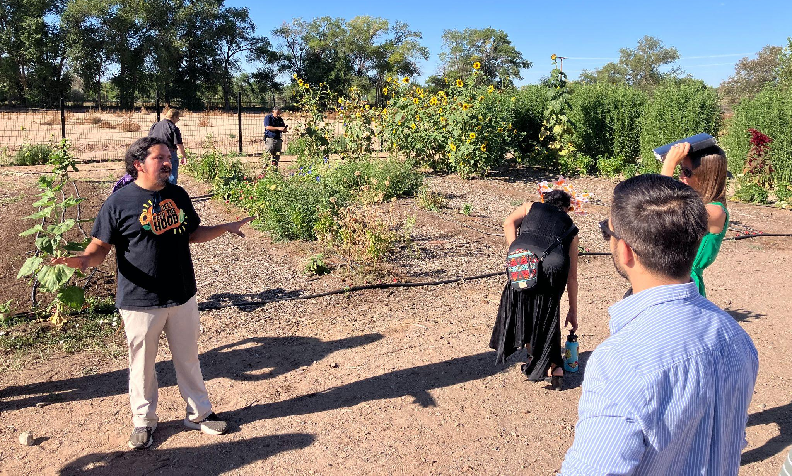
Urban Agriculture & Soil Health
Project Areas

Slide 24
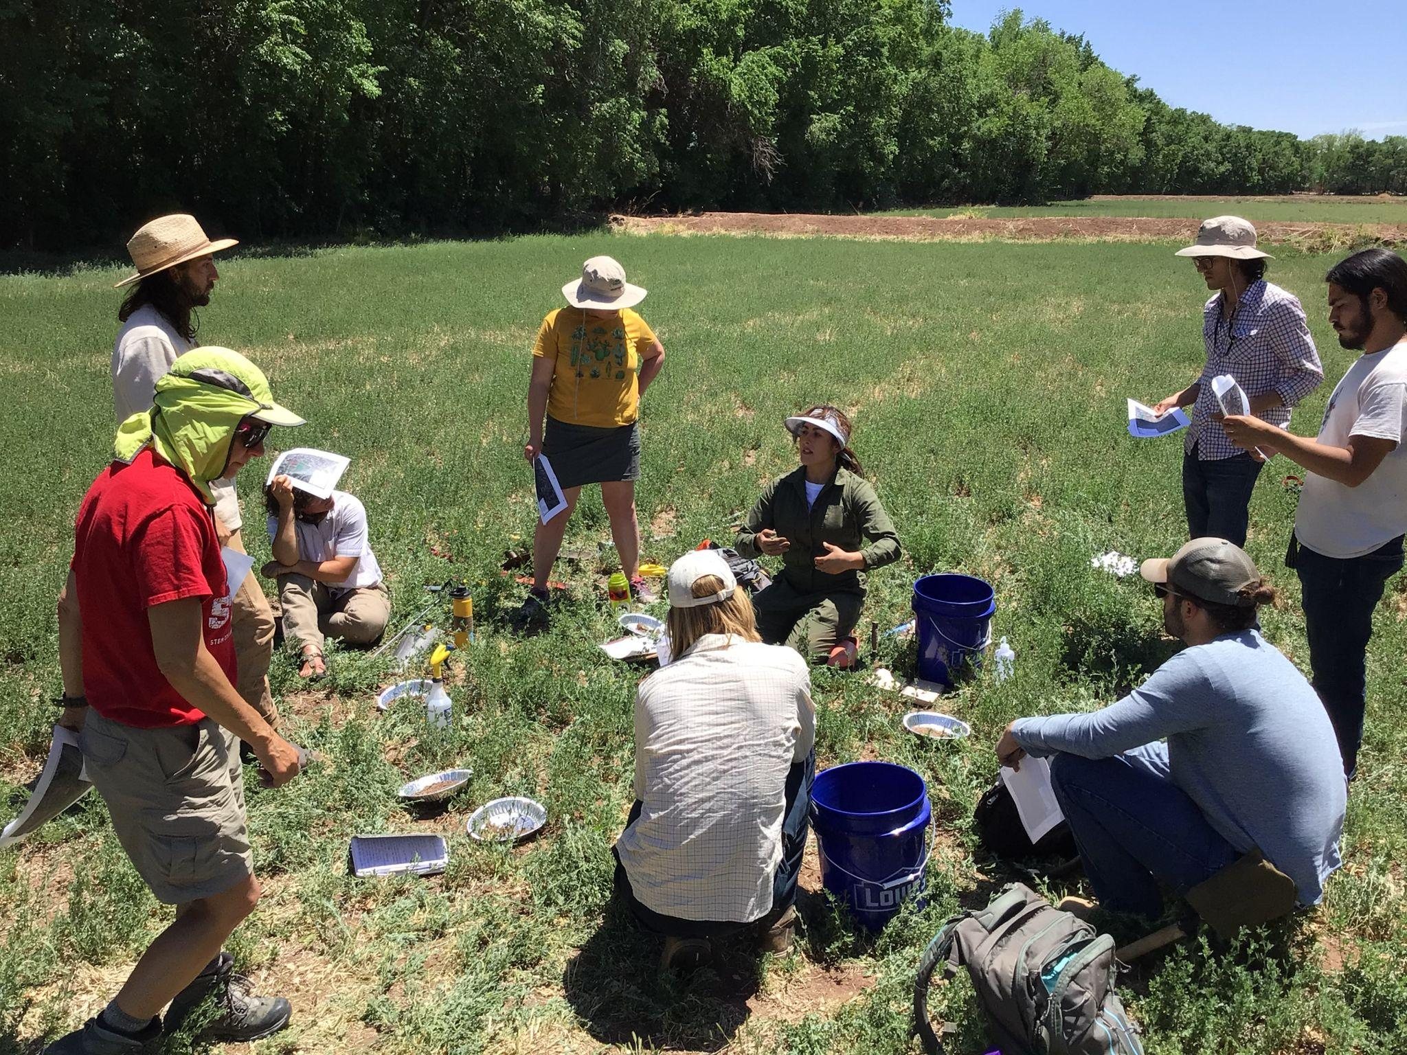

Urban Agriculture & Soil Health
Natural Resource Conservation Service
    Conservation Outreach grant
  Apprentice Technical Assessors training/deployment
  SSCAFCA match to support >100 soil samples
Bernalillo County
    Intergovernmental Agreement
  Grow the Growers urban ag training and internships
  Rio Grande High School agricultural internships
  Conservation Easements support (with RGALT)
Project Areas

Slide 25
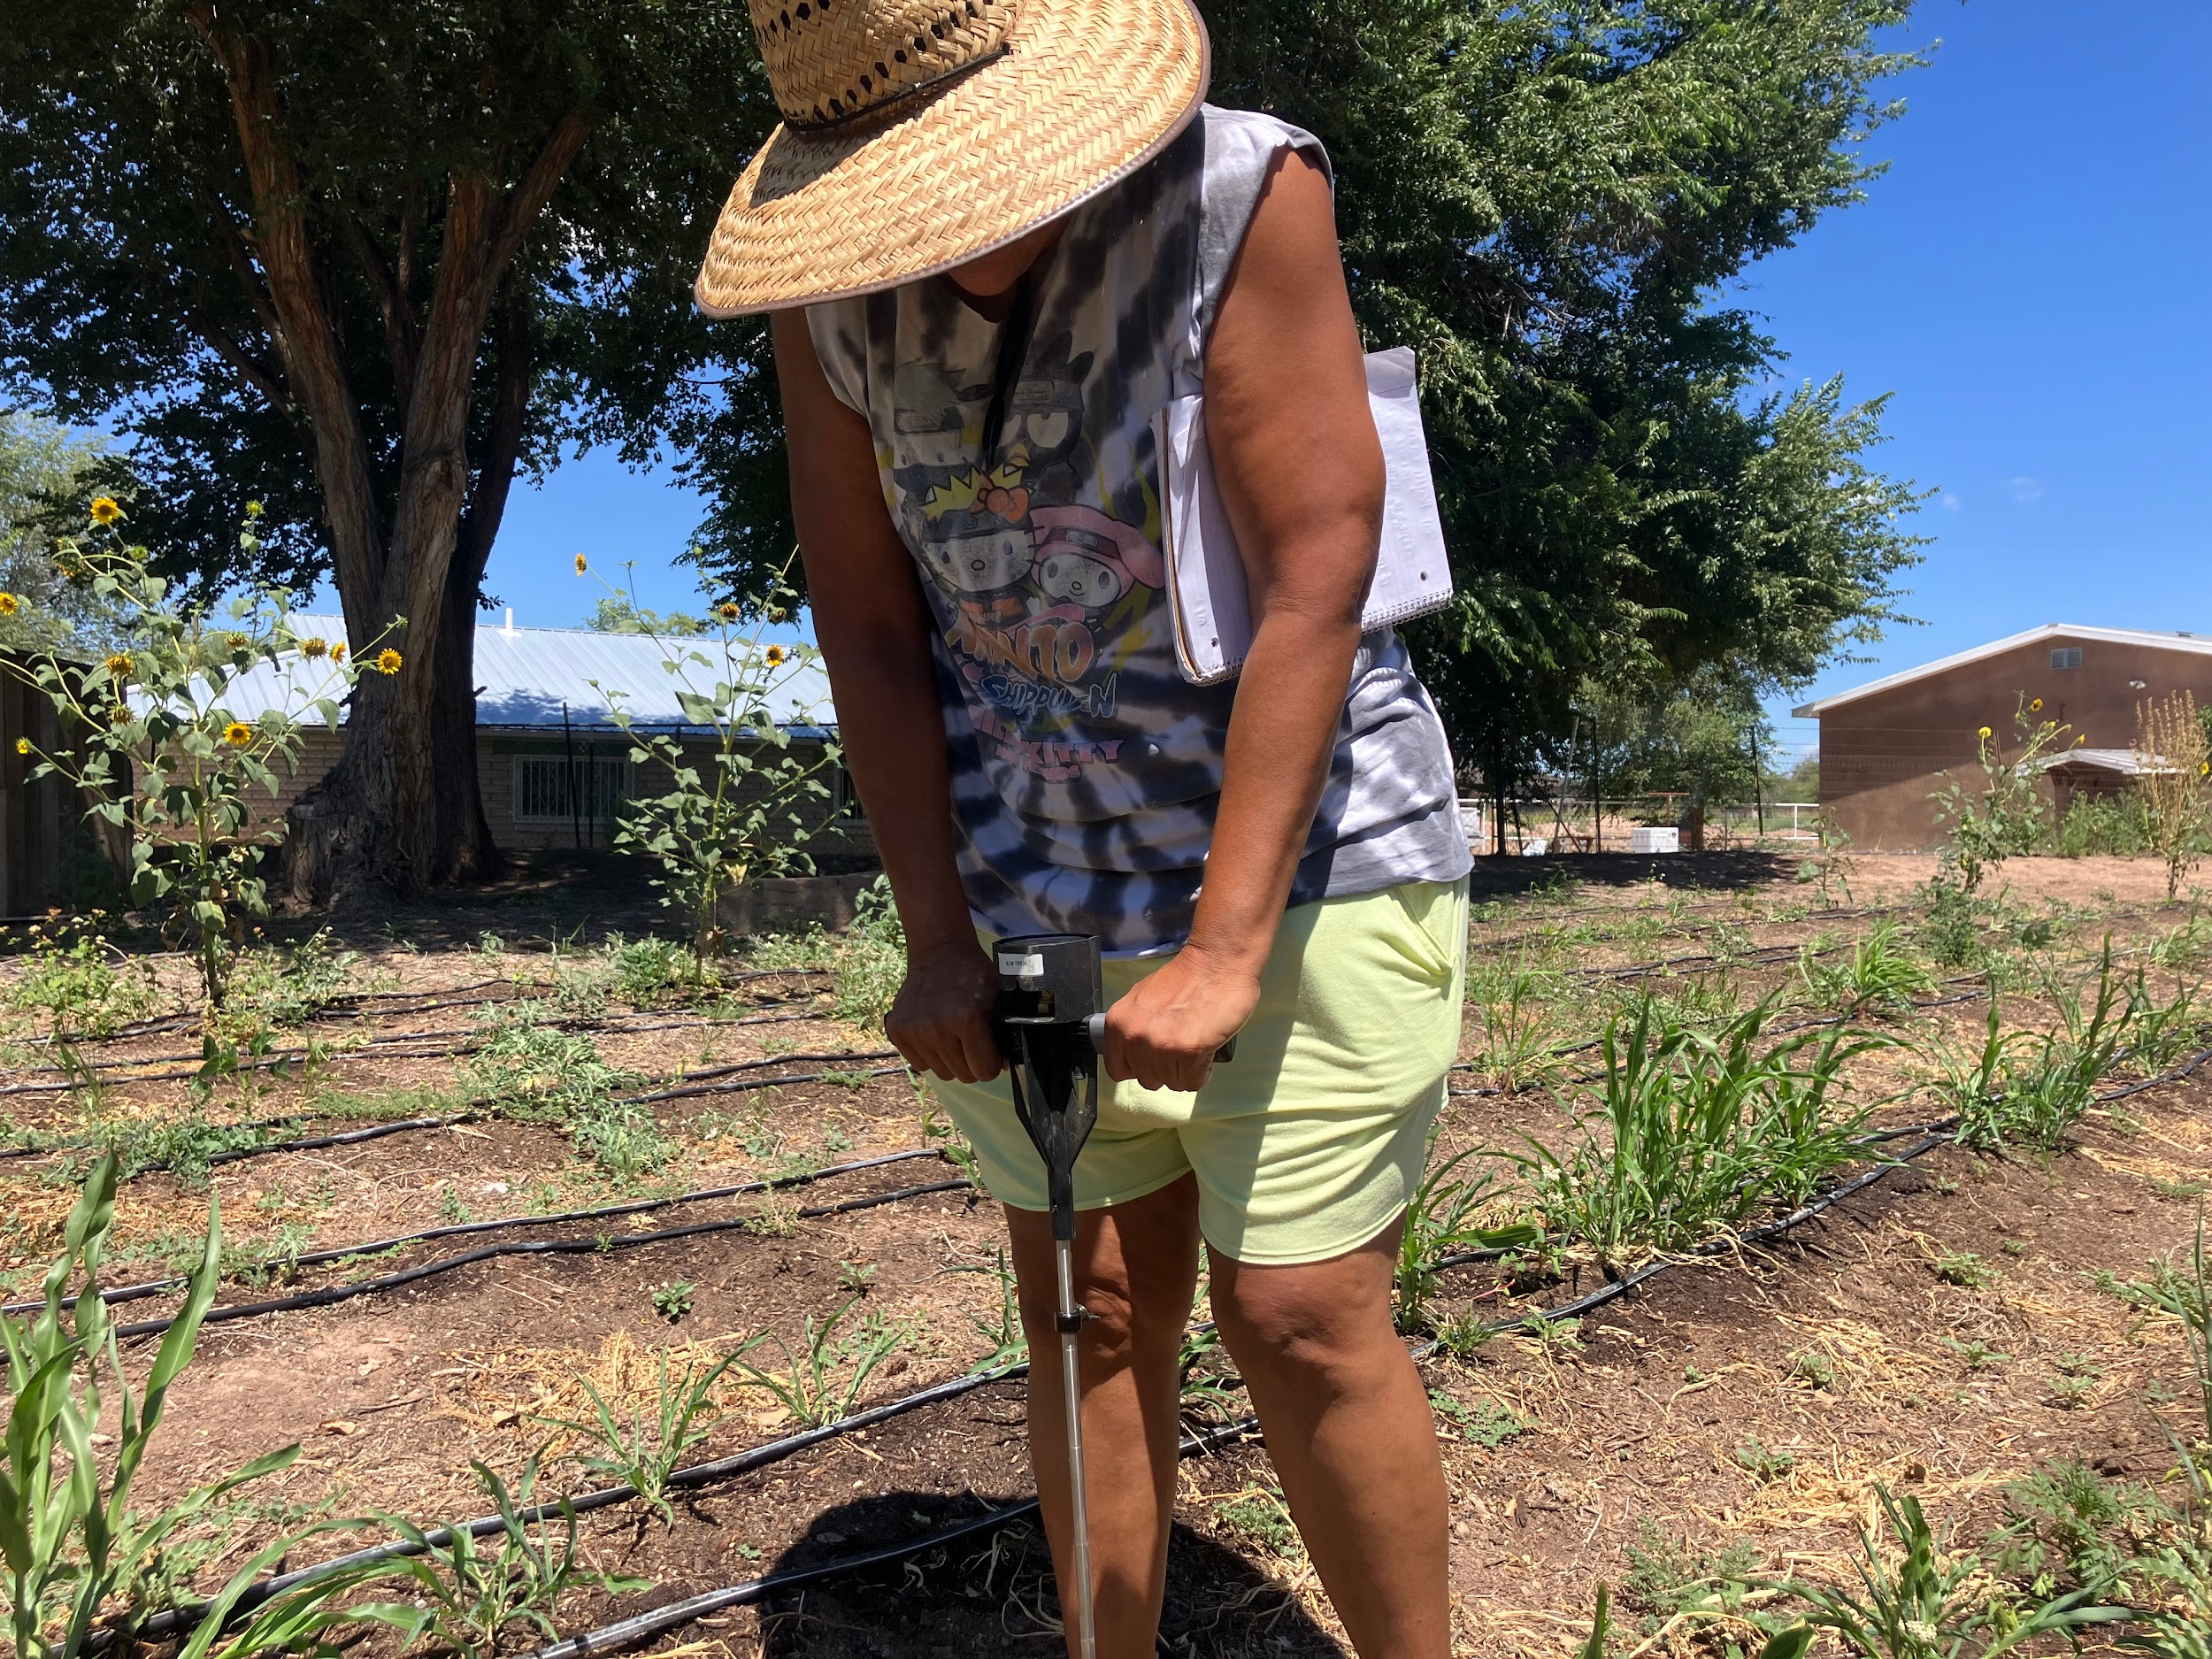
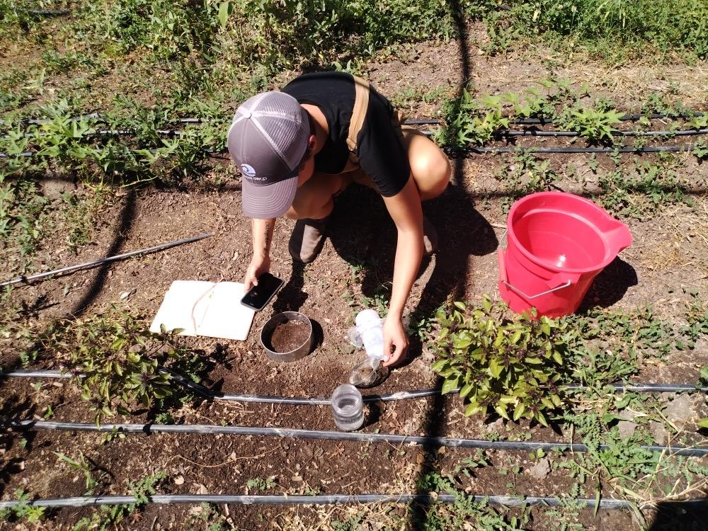
Urban Agriculture & Soil Health
New Mexico Department of Agriculture
    Healthy Soil Program grants
  Candelaria Nature Preserve
  Gutierrez-Hubbell farm (Grow the Growers)
  23 independent, sponsored healthy
  soil projects (2020-2024)
Project Areas

Slide 26
Urban Agriculture & Soil Health
US Department of Agriculture
    Composting and Food Waste Reduction Grant
  Collaboration with Martineztown NA and Indigenous Food Hub to establish community composting sites
US Environmental Protection Agency
    Recycling Education and Outreach Grant
  Collaboration with Polk Middle School and Agriculture Magnet School Cluster in the South Valley
  Goal: Develop composting practices, curriculum, and outreach materials with teachers and students to reduce and divert food waste
and increase sustainability
practices in APS
Project Areas

Slide 27
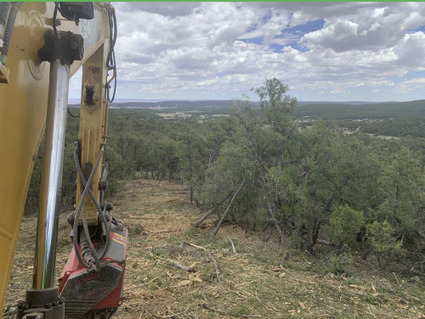
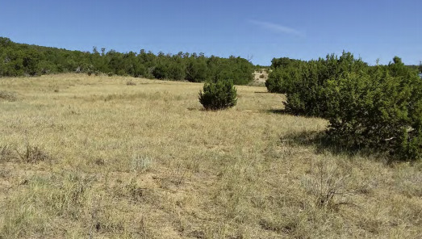
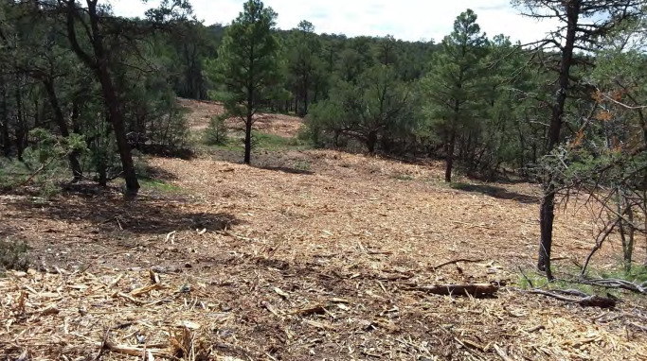

WUI Wildfire Risk Reduction
Loma Ponderosa Open Space Trust Land Property thinning project (Albuquerque Open Space)
Project Areas

Slide 28
WUI Wildfire Risk Reduction
NMEMNRD State Forestry Division
    Non-Federal Lands grant
    WUI Hazardous Fuels grant
  East Mountain Community Wildfire Protection Plan (Updated 2015; informed 2022 BernCo CWPP))
  Land owner cost-share thinning program (>20 years)
  Fuels reduction on public open space properties
  > Bernalillo County: Sedillo Hill, Carlito Springs
  > City of Albuquerque: Loma Ponderosa, Juan Tomas,
  Milne-Gutierrez
New Mexico Counties
    Rural Communities Wildfire Risk grant
  Green Waste Days collaboration with BernCo
  Land owner cost-share thinning
Project Areas

Slide 29
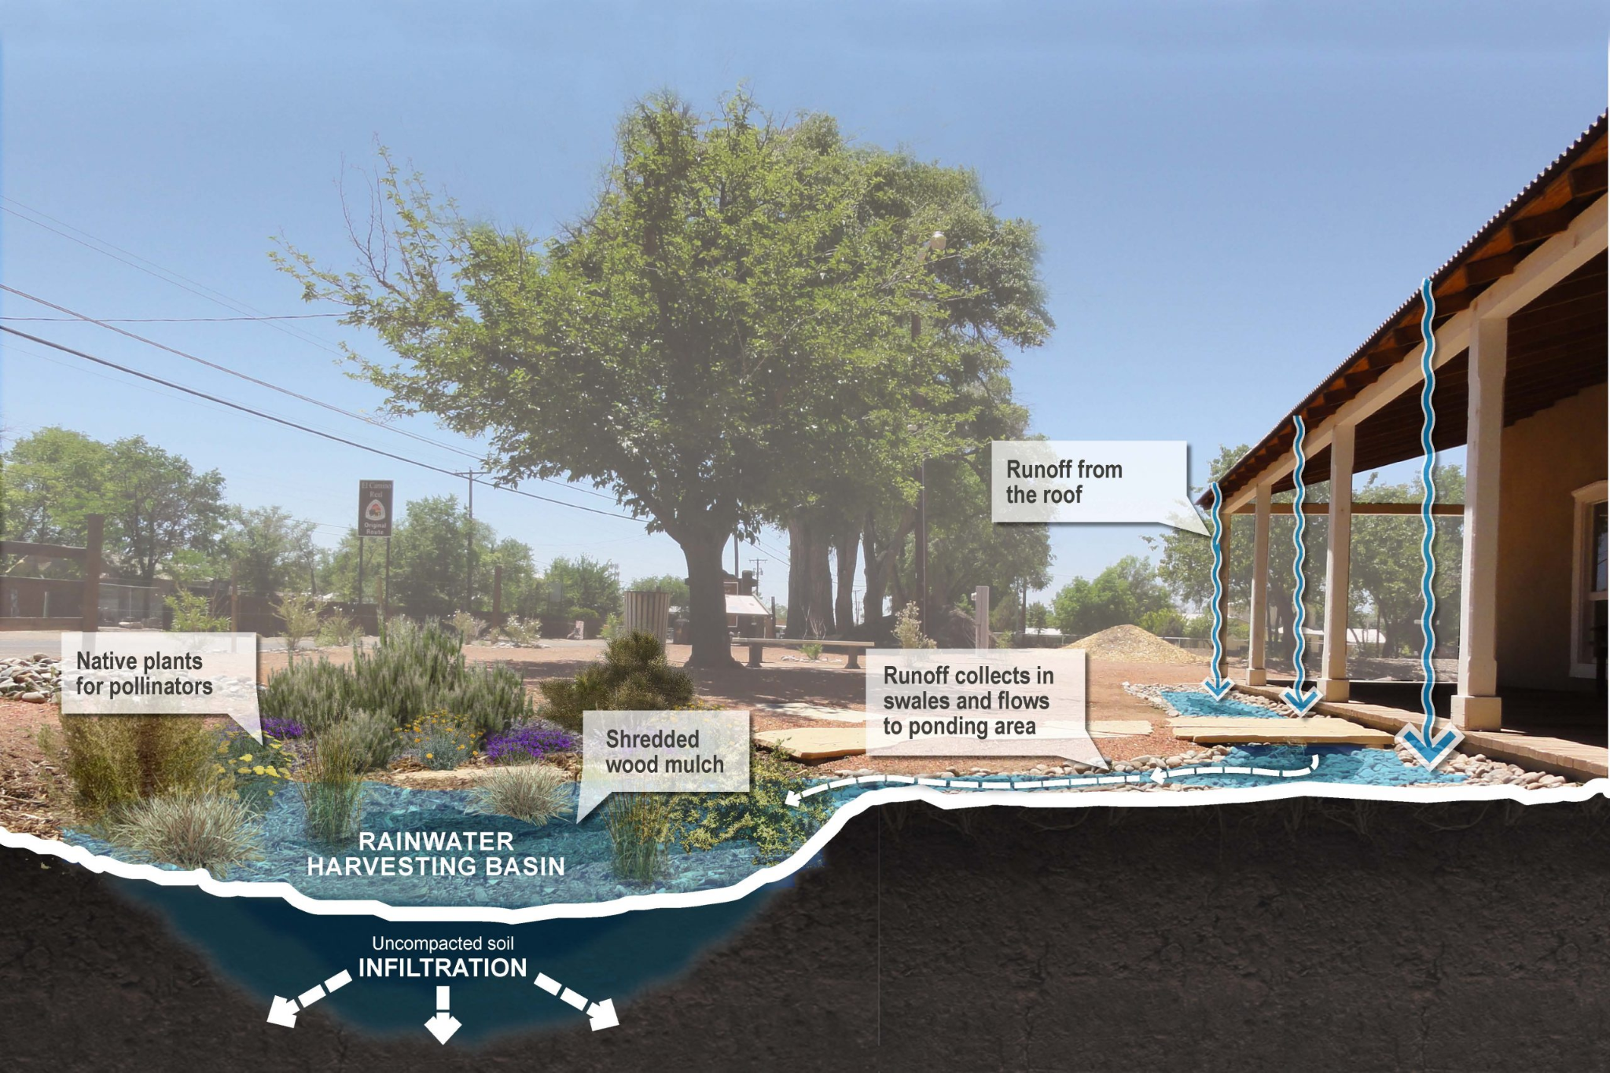
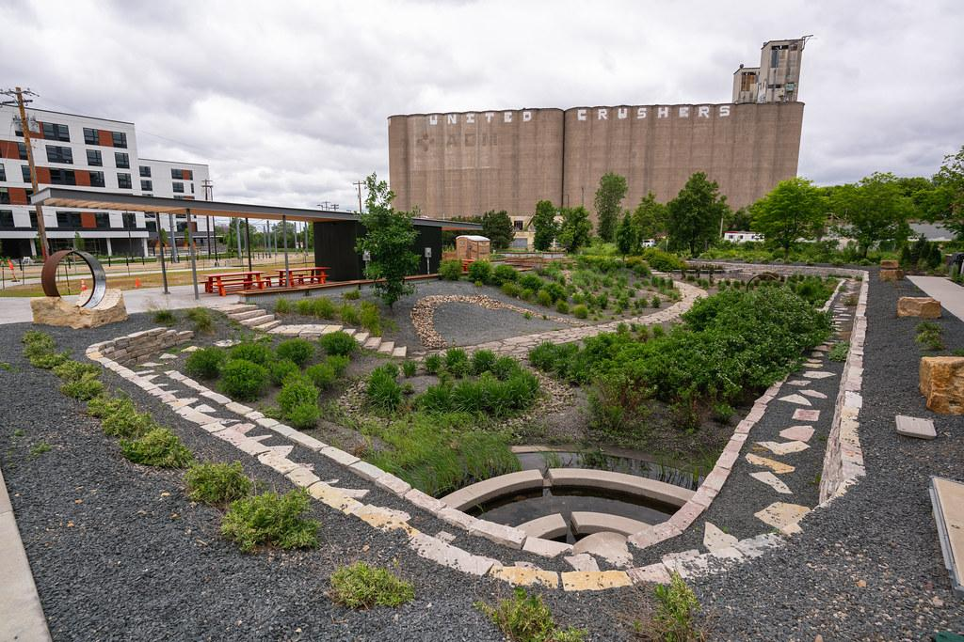

WUI & Urban Runoff Control
Project Areas

Slide 30

WUI & Urban Runoff Control
New Mexico Environment Department/USEPA
    CWA 319(h) grants
  Tijeras Creek Remediation Project (2003)
  Tijeras Creek Watershed Restoration Strategy (2004)
  Septic system info brochure series (2017)
  Upper Tijeras Creek Watershed-Based Plan with BernCo and CABQ (2021, EPA approved!)
    CWA 604(b) grants
  Watershed-Based MS4 permit negotiations and resource allocation model (2009-2011)
  E. coli survival/reproduction in Rio Grande
  sediments (2018, AMAFCA collaboration)
Project Areas

Slide 31
WUI & Urban Runoff Control
NM Department of Agriculture/Bernalillo County
    Water Quality & Conservation grant
  TCRP Phase II repair and expansion (2013)
    WQ&C grant/Alliance for Water Efficiency Learning Landscapes grant (BernCo collaboration)
  Residential Rainwater Harvesting Ambassadors
  Distributed urban green stormwater infrastructure
Project Areas

Slide 32

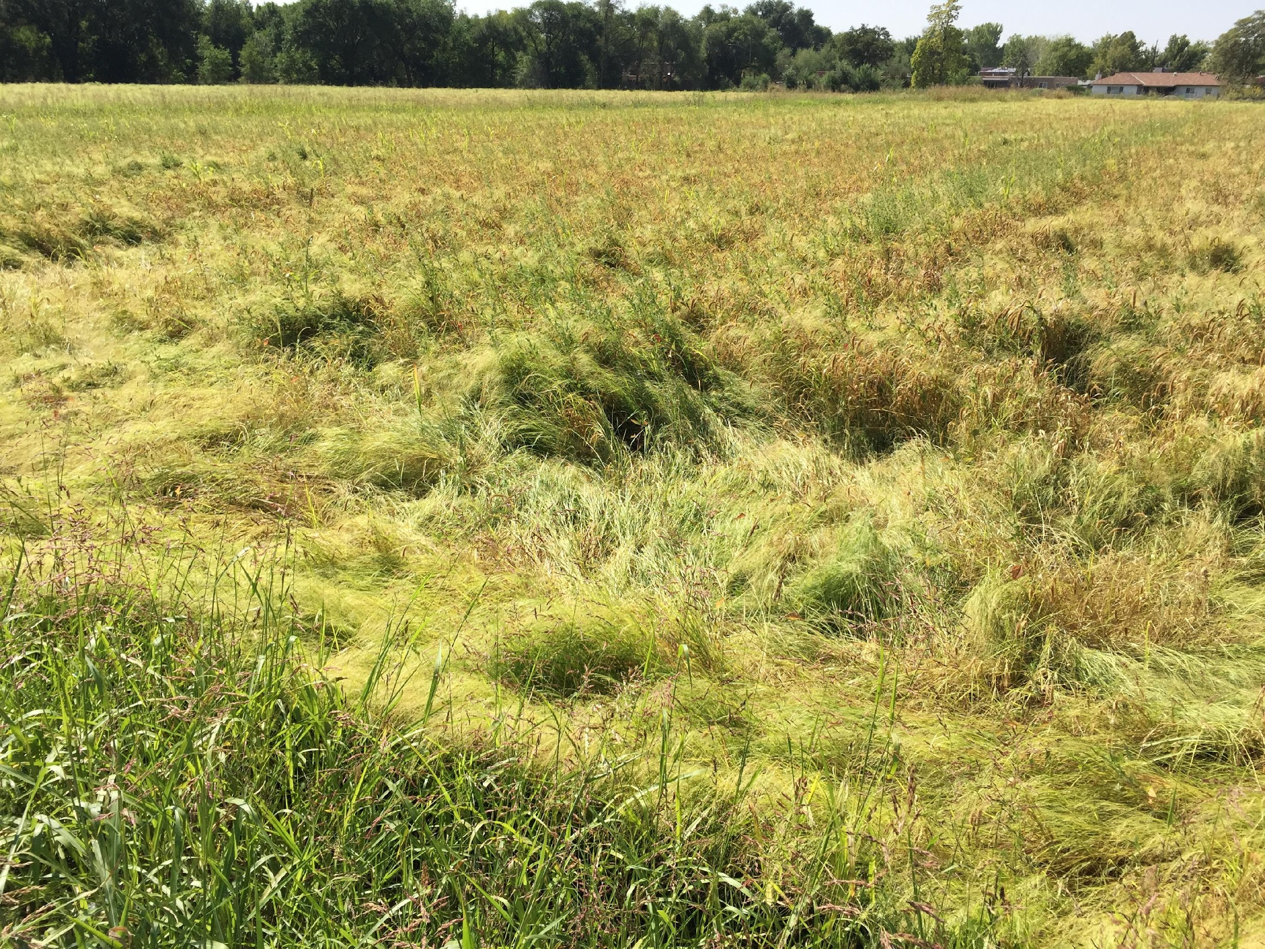
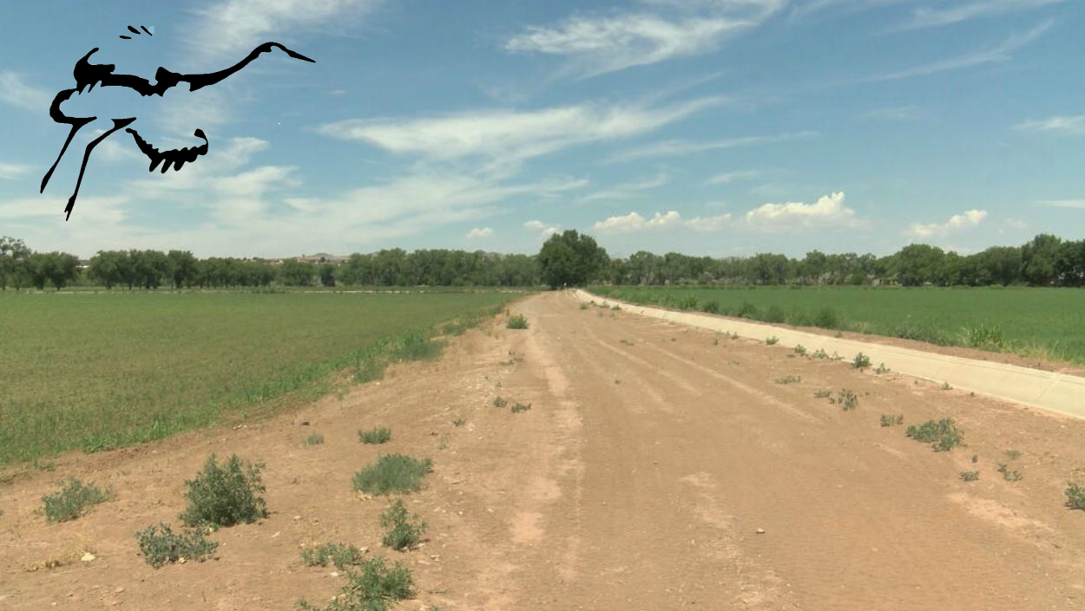
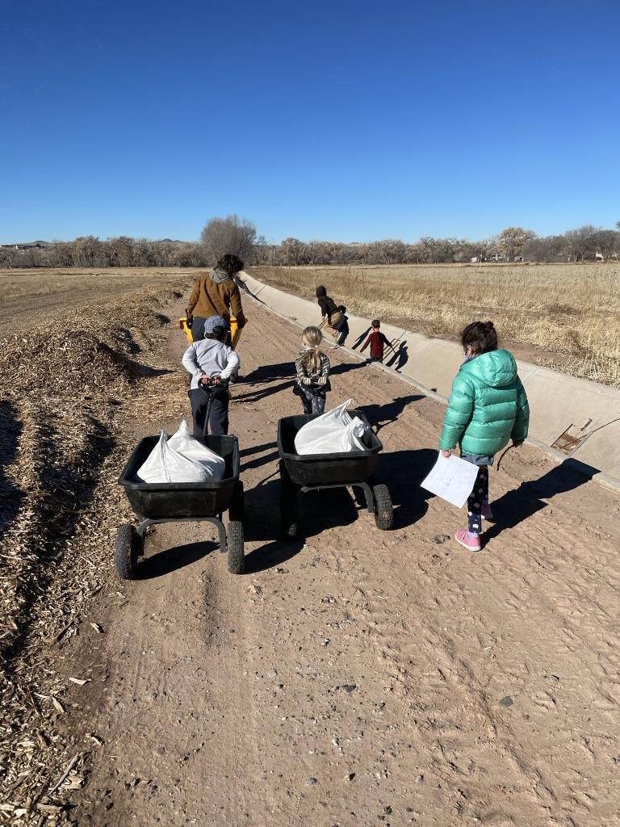
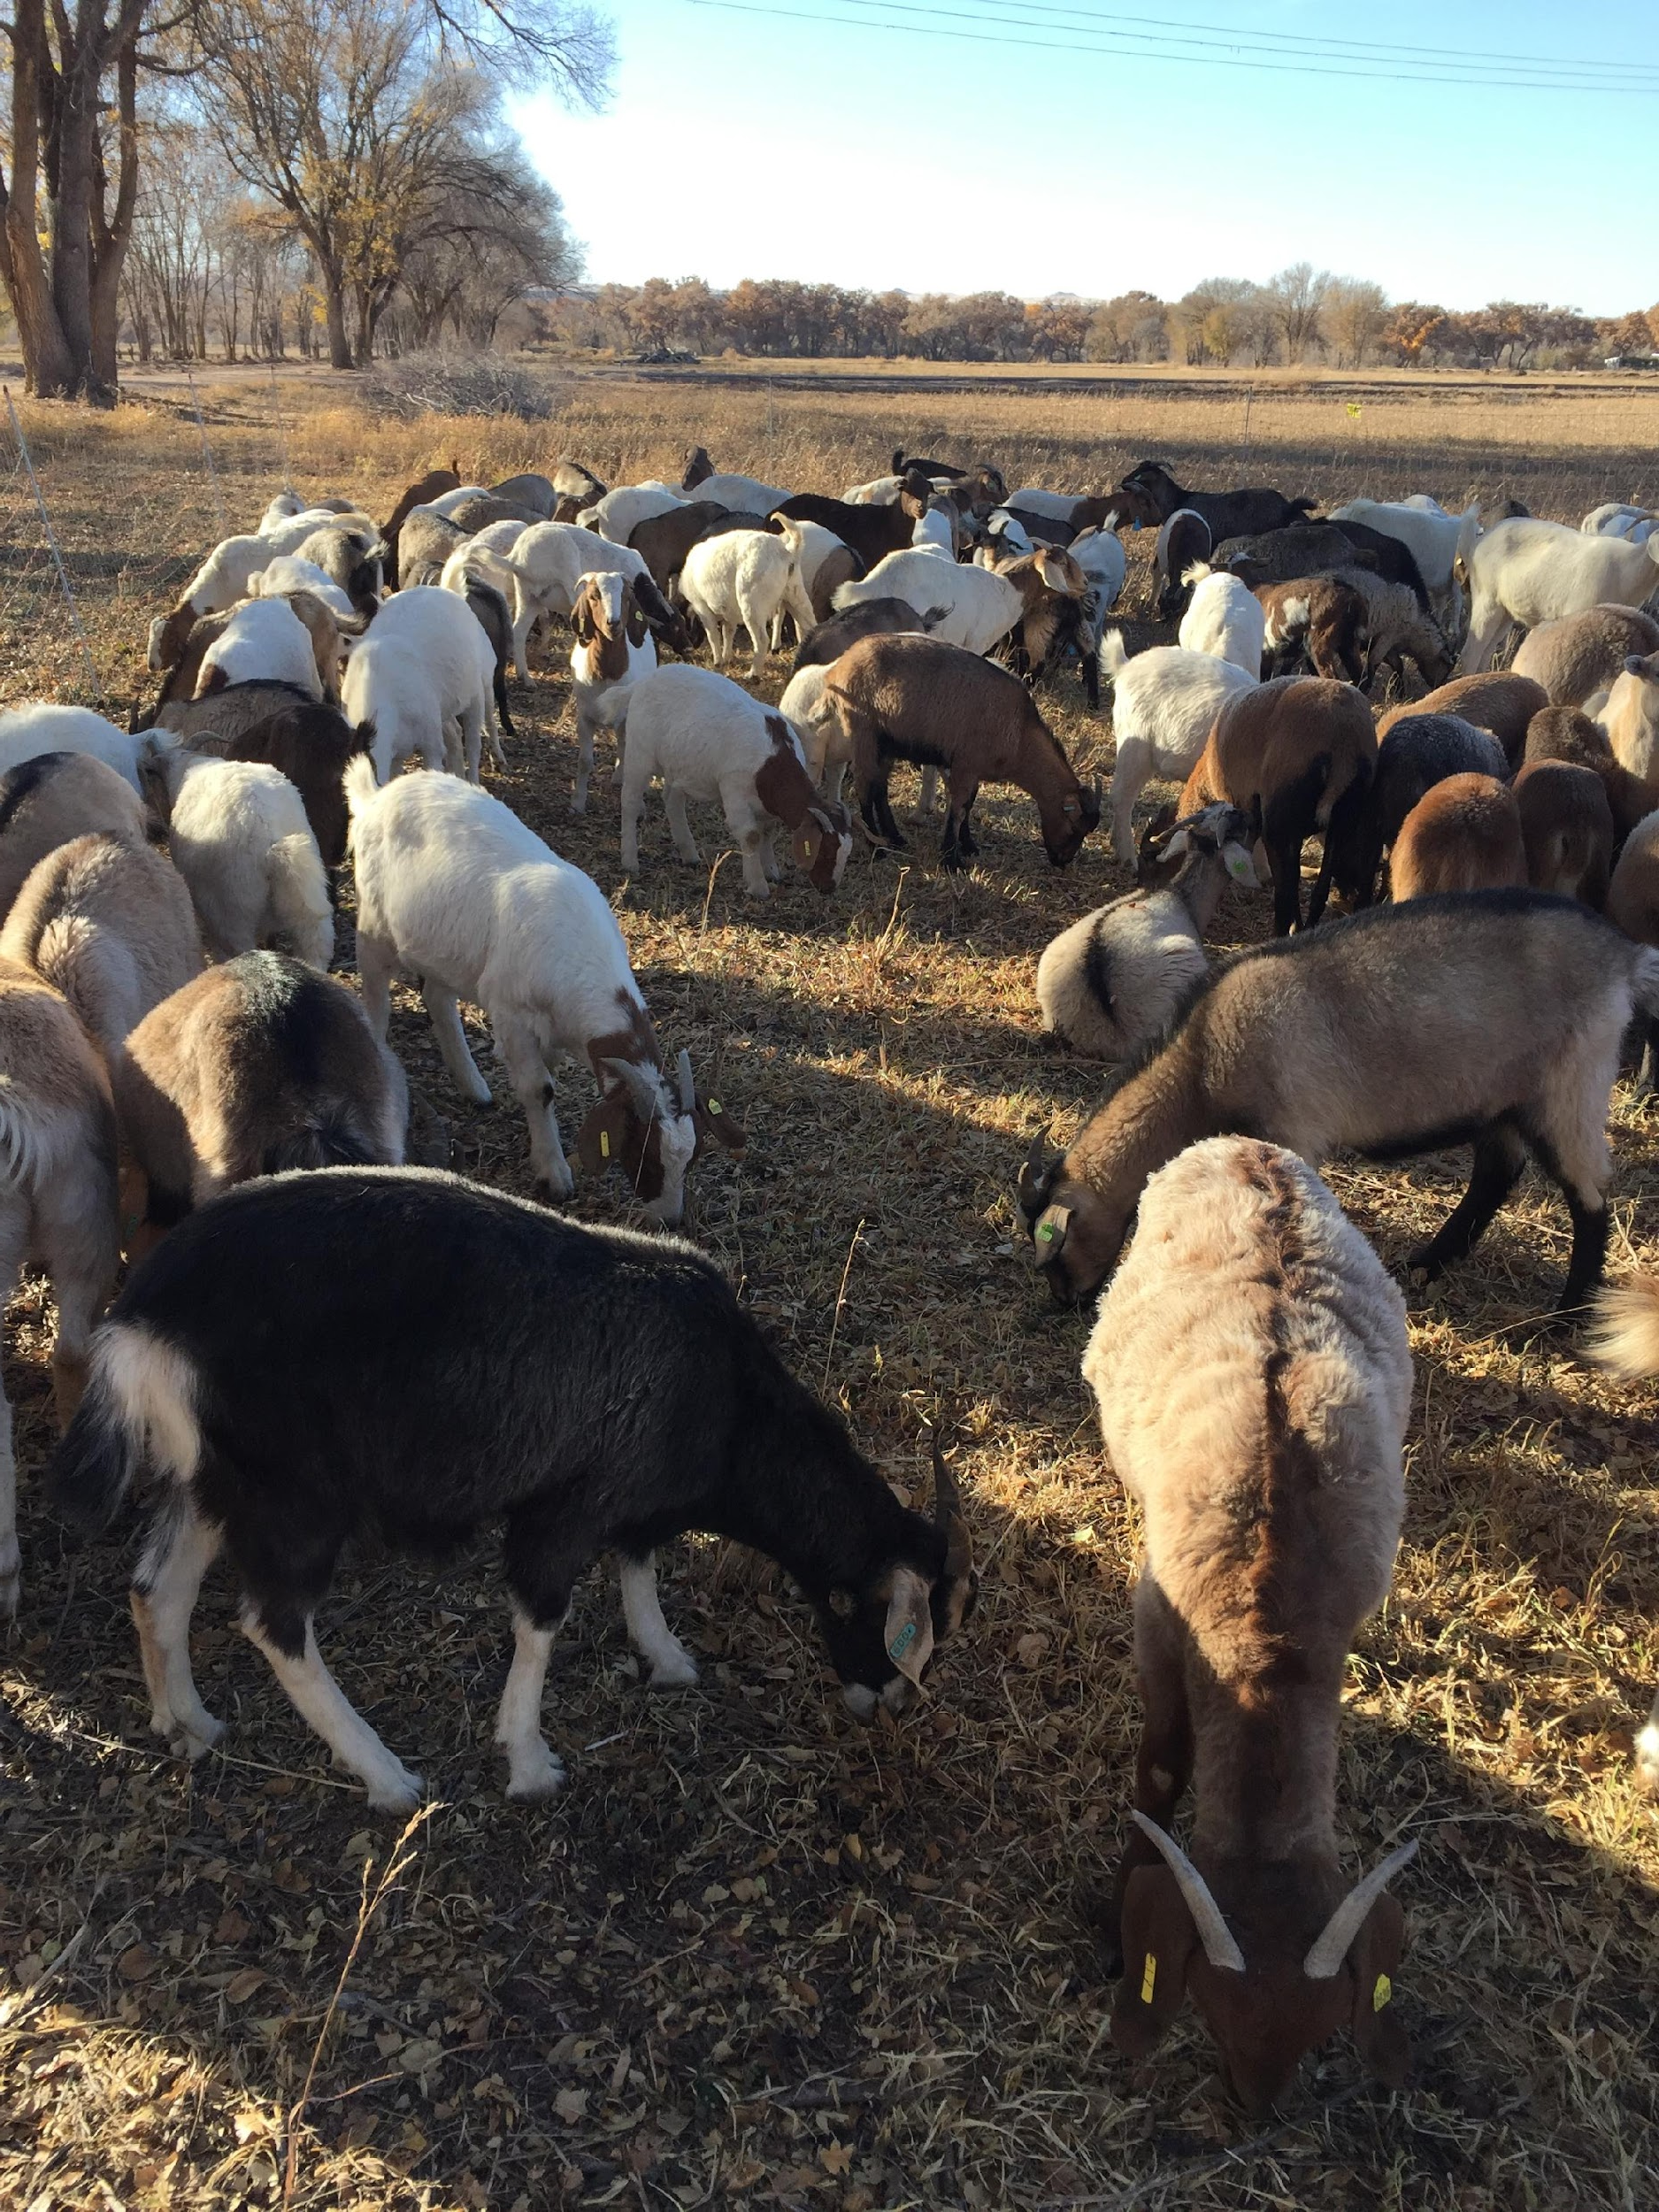

Wildlife/Wetlands/Watersheds
Project Areas

Slide 33
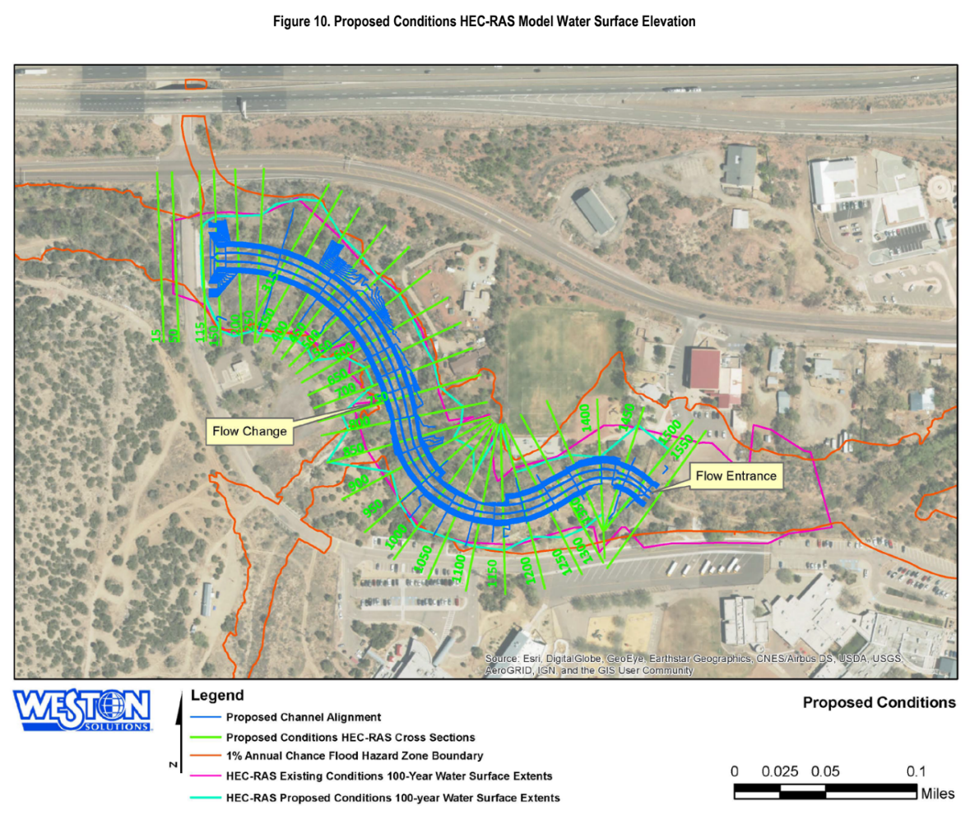
Wildlife/Wetlands/Watersheds
New Mexico Environment Department/USEPA
    NMED River Stewards grant
    SWCC Special Appropriation Grant
  Bernalillo County collaboration
  12-acre parcel regrading & Tijeras Creek realignment
  Invasive species removal, native species plantings
  Vegetation transects before and after
Project Areas

Slide 34
Wildlife/Wetlands/Watersheds
NMEMNRD Forestry Division
    Landscape Scale Restoration grant (pending)
  Targeted floodplain restoration along 7 miles of Tijeras Creek
NM Department of Outdoor Recreation
    Trails+ grant
  GEM Inclusive Sensory Trail, an ADA+ trail at Tijeras Biozone Education Center
NM Department of Agriculture & City of Albuquerque
    Water Quality & Conservation grant
    Healthy Soil grant
    Joint Powers/Lease Agreement
  Candelaria Nature Preserve conversion
  ~60 acres to wildlife grains and habitat
  Collaboration with Rio Grande Return
Project Areas

Slide 35
… and there’s more!
www.CiudadSWCD.org
www.facebook.com/CiudadSoilAndWaterConservationDistrict/
www.instagram.com/ciudadswcd/
More Information

Slide 36
CIUDAD SOIL AND WATER CONSERVATION DISTRICT:
PARTNERS IN CONSERVATION
September 2024
We’re from the government. How can we help you?

